Slide 1
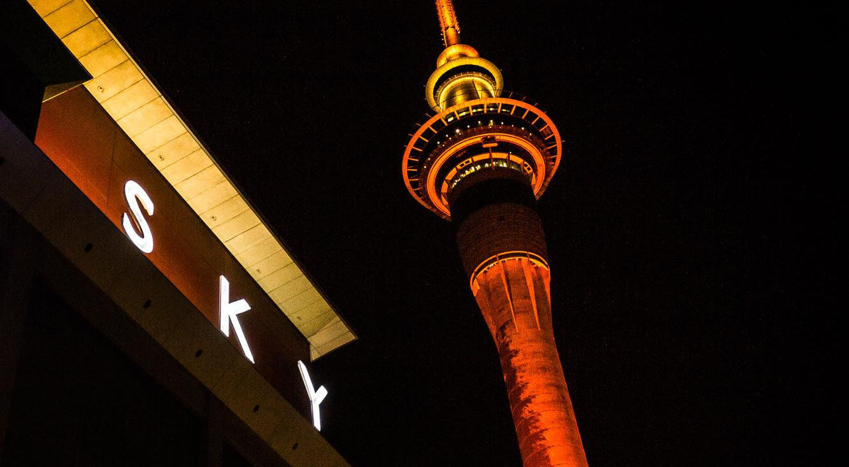
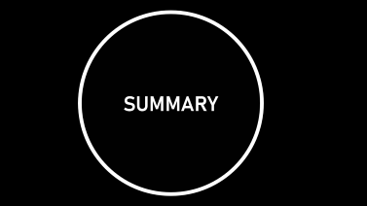
Sky City Entertainment Group (NZX: SKC)
Massey University
CFA CHALLENGE 2025
Akshay Kapoor
Jamie Barker
Joshua Gomez
Tomasz Osuchowski
MARKET PRICE AS OF 17 OCTOBER: $1.38
TARGET PRICE: $1.33 (3.4% DOWNSIDE)
RECOMMENDATION: SELL

Slide 2


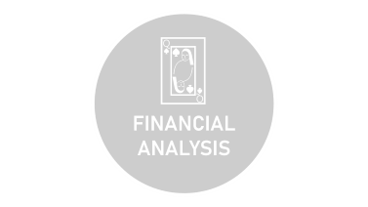






Slide 3
♤
DRIVERS

Slide 4
♤
DRIVERS
Conservative Stance to Capital Management
Erosion of Cash Poses a Threat to the Firm
Regulatory Environment Poses Challenges

Slide 5
🂾
BUSINESS

Slide 6
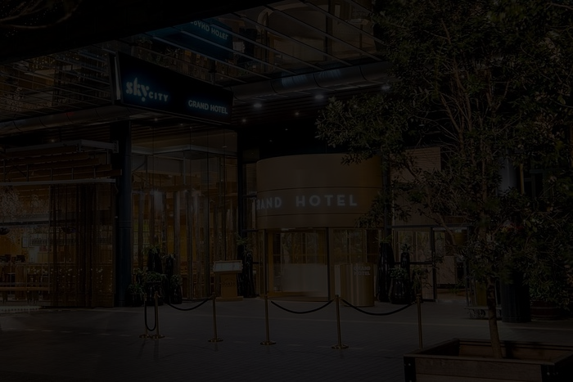
🂾
BUSINESS DESCRIPTION
Four entertainment precincts: Auckland, Hamilton, Queenstown and Adelaide
SkyCity owns and operates casinos, hotels, bars, restaurants, convention centres and tourist attractions
SkyCity also operates an online casino based out of Malta
SKC is the only publicly listed casino operator in New Zealand

Slide 7
♧
OVERVIEW

Slide 8

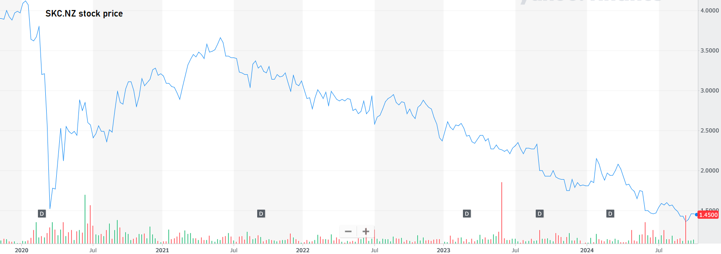
♧
SHARE PRICE PERFORMANCE
AUSTRAC Investigation Begins 7 June 2021
SKC stock crashed due to COVID-19 panic starting in January 2020, then began to recover
However, the Australian Transaction Reports and Analysis Centre (AUSTRAC) began to investigate SkyCity during 2021

Slide 9
♧
REGULATORY BREACHES AND FINES 2024
SkyCity has faced several fines and closures this year alone
$73.6 million for Anti-Money Laundering breaches at SkyCity Adelaide
Regulatory Breach | Cost | Date
Anti-money Laundering Breach | $4.16M | 25/09/2024
Vulnerable player loses $1m | 5-day closure ($5M loss) | 9/09/2024
Breaching its own host responsibility programme | 7-day closure ($5M loss) | 21/08/2024
Breaches relating to its harm minimisation obligations. DIA investigation | 5-day voluntary closure of gambling operations ($5M loss) | 18/07/2024
AML breaches | $73.6M | 17/05/2024
Money Laundering Laws in NZ | SKC agreed to pay a nearly $4 million fine | 21/02/2024
Regulatory compliance issues | $13.8M | 21/02/2024

Slide 10
🂭
FINANCIAL ANALYSIS

Slide 11
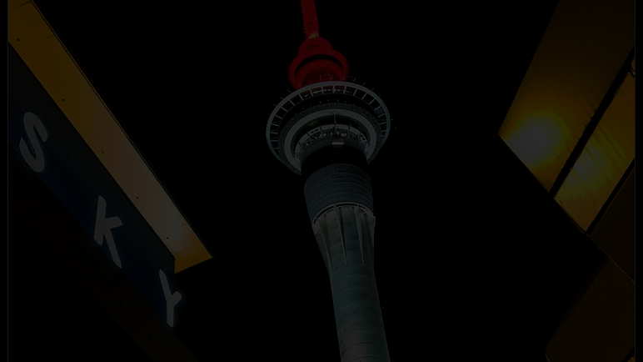
🂭
FINANCIAL ANALYSIS
Current segment performance
Auckland: Slower performance in gaming revenue due current economic environment plus higher labour costs
Adelaide: Higher premium table games win rate and reduction in expenses mainly FTE reduction
Hamilton & Queenstown: Slower core performance and lower visitations in South Island
Online: Lower bet sizes and number of players
Others: Increase included higher one-off costs offset by companywide cutting initiatives
Key Segments | FY 2022 | FY 2023 | FY 2024 | FY 2025 | FY 2026
Auckland | 100.9 | 251.5 | 237.0 | 211.3 | 200.2
Adelaide (In A$) | 20.5 | 32.9 | 36.5 | 31.5 | 30.0
Hamilton & Queenstown | 27.5 | 39.3 | 35.0 | 35.7 | 36.4
Online | 12.9 | 10.7 | 5.7 | 7.4 | 7.6
Others | (23.9) | (32.6) | (34.3) | (36.0) | (11.8)
Total EBITDA | 137.9 | 301.8 | 277.8 | 249.8 | 262.5
Forecast
Auckland: FY 25 EBITDA impacted due to slower economic growth, lower bet sizes, one-off costs etc.
FY 26 EBITDA impacted due to mandatory carded play
Adelaide: FY 25 EBITDA impacted due to lower visitations in South Australia
FY 26 EBITDA impacted due to mandatory carded play
Rest NZ: Slightly rise due to better product offerings, cost optimizations etc.

Slide 12
⚂
VALUATION

Slide 13
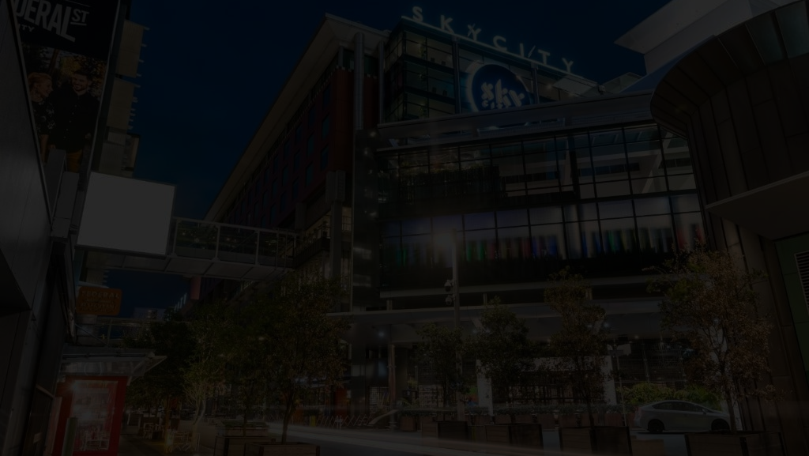
⚂
VALUATION
Weights
Target Price
$1.33
Last Close
$1.38
$1.32
$1.62
$1.21
$1.40
$1.28
$1.40
Weighted Valuation Target: SKC $1.33
Cost of Debt | Cost of Equity | WACC | Terminal Growth
7.88% | 15.09% | 11.34% | 2.0%
 | Downside: | 3.4%

Slide 14
Our Multi-Stage DDM
Payout Ratio
Adj. DPS
SKC Dividend Payout Policy
 |  | 2017 | 2018 | 2019 | 2020 | 2021 | 2022 | 2023 | 2024
DPS (cents) | $c | 0.200 | 0.200 | 0.200 | 0.100 | 0.700 | 0.000 | 0.120 | 0.053
YoY | % |  | 0.000 | 0.000 | -0.500 | 6.000 | -1.000 | - | -0.563
Payout Ratio | % | 1.998 | 0.502 | 0.879 | 0.566 | 0.333 | 0.000 | 0.636 | 0.693
DPS Theoretically | $c | 0.239 | 0.079 | 0.152 | 0.048 | 0.038 | - | 0.117 | 0.106
Difference | $c | -0.039 | 0.121 | 0.048 | 0.052 | 0.662 | - | 0.003 | -0.053
60%
90%
80%
* Team Consensus set payout ratio at 80%
Adj. Factor
11.3%
Forecasted Dividend PMT
 | FY25 | FY26 | FY27 | FY28 | FY29 | FY30 | FY31 | FY32 | FY33 | FY34 | Terminal Value
Dividends per Share (DPS) | 0.000 | 0.205 | 0.210 | 0.212 | 0.214 | 0.217 | 0.220 | 0.223 | 0.226 | 0.229 | 1.788
DPS Growth (g) |  |  | 2.6% | 0.8% | 1.0% | 1.2% | 1.5% | 1.5% | 1.4% | 1.5%
Present Value (PV) | 0.000 | 0.155 | 0.138 | 0.121 | 0.106 | 0.093 | 0.082 | 0.072 | 0.064 | 0.056 | 0.439
DDM Target: $1.33

Slide 15
⚂
Sensitivity Analysis
Change in Capex | DCF
8% | $1.28
7% | $1.28
6% | $1.29
5% | $1.29
4% | $1.30
3% | $1.31
2% | $1.31
1% | $1.32
0% | $1.33
-1% | $1.33
-2% | $1.34
-3% | $1.35
-4% | $1.35
-5% | $1.36
-6% | $1.37
-7% | $1.37
-8% | $1.38
Our Multi-Stage DCF
 | DCF TARGET: | SKC $1.31
Cost of Debt | Cost of Equity | WACC | Terminal Growth
7.88% | 15.09% | 11.34% | 2.0%
 | Downside: | 5.07%
DCF Valuation
 | Intrinsic Value | Weights
FCFF | $1.34 | 25%
FCFE | $1.34 | 25%
Gordon Growth | $1.29 | 50%
Total Weighted DCF | $1.31

Slide 16
🂠
INVESTMENT RISKS

Slide 17

🂠
INVESTMENT RISKS
R1) Regulatory: Mandatory carded play will negatively affect future revenue streams
R2) Debt: Surging debts; debt refinancing could be an issue
R3) Economic: Inflation hangover amidst lower discretionary spending, causing higher operational costs
R4) Management: 6 out of 17 board members have been at SkyCity for less than one year
R5) Cash Flow & Liquidity: Declining cash reserves and negative working capital threaten SkyCity’s credit rating
Likelihood |  |  |  | R1
 |  |  | R2
 |  | R4 | R5 | R3
 | Severity

Slide 18

ESG PILLARS

Slide 19

ESG PILLARS
Environmental: Strong on climate exposure & energy management, sustainability initiatives, emissions reduction
Social: Excellent in customer welfare and responsible gambling
Governance: Diverse Board of Directors
Challenges: Improving data security and ethics compliance

Slide 20

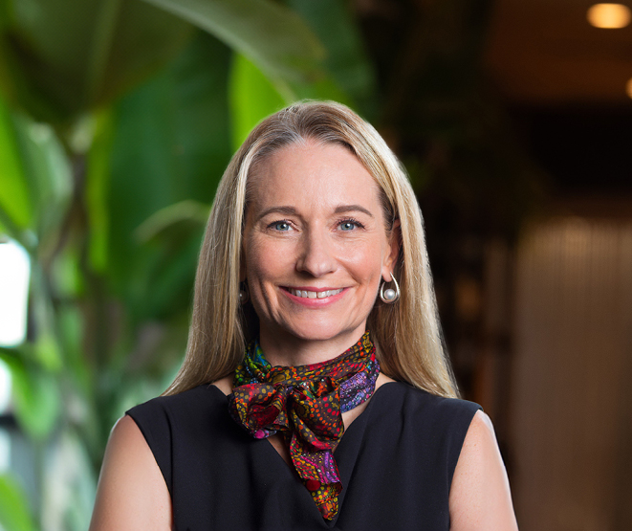
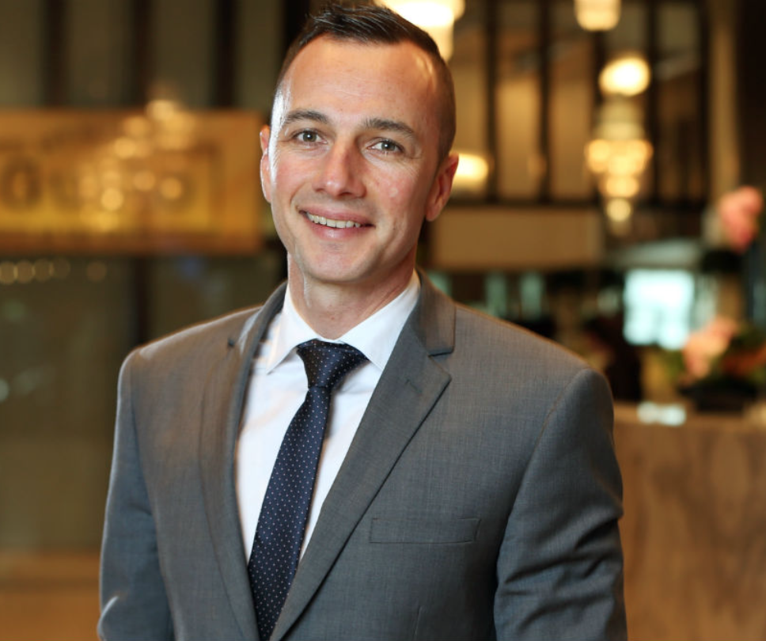


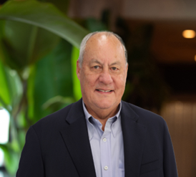
ESG PILLARS
Avril Baynes
Managing Director/Interim COO: Australia
Brad Burnett
Gen Mgr: Auckland
Callum Mallett
COO: New Zealand & Australia
Jason Walbridge
CEO
Peter Fredricson
CFO

Slide 21
SUMMARY

Slide 22
Appendix Menu
Conservative Stance to Capital Management
Thesis I:
Net Debt/EBITDA
Thesis II:
Erosion of Cash Poses a Threat to the Firm
Debt Profile
Erosion of Cash
Thesis III:
Regulatory Environment Challenges
Regulatory Environment Poses Challenges
Valuation:
Cost of Equity Calculation
COE Sensitivity Analysis
Terminal Growth Rate
Exit Multiple
Dividend Discount Model
Sky City Entertainment Group (NZX: SKC)
Online Gambling Projection
Investment Summary
MARKET PRICE AS OF 17 OCTOBER: $1.38
TARGET PRICE: $1.33 (3.4% DOWNSIDE)
RECOMMENDATION: SELL
Macro-Economic Environment:
Economic Forecasts & Business Confidence

Slide 23
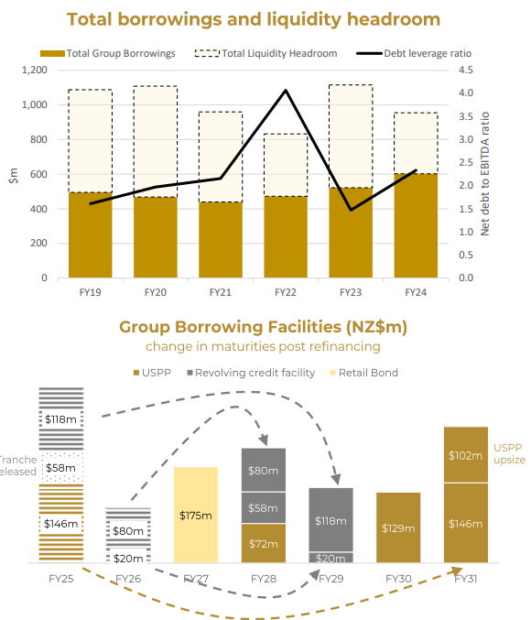
Debt Profile
Group net debt of $670M as at 30th Jun’24, representing borrowings ($603M), and leases ($121M) offset by cash $61M
Liquidity headroom of $217M, reflected unutilised, committed syndicated debt facility ($252M) and cash reserves
Net debt/EBITDA ratio of 2.3x, in line with guidance and within covenants and investment grade credit rating metrics
Successful early refinance of selected tranches of debt maturing in 2025 and 2026:
US$150M of USPP debt negotiated with 7-year tenor (Sep’2031)
Extended $217.5M of syndicated debt facility to FY28 and FY29
No debt maturing before 2027
Board suspended FY24 final dividends and FY25 dividend payments to maintain conservative balance sheet ratings
Current S&P debt ratings of BBB-
Medium term expected rating target BBB

Slide 24
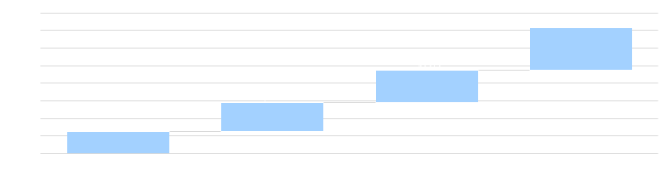
Cost of Equity Calculation
CAPM
Fama-French 5 Factor Model
Cost of Equity
14.43%
Weight
40%
Cost of Equity
15.53%
Weight
60%
Weighted Beta 1.10
Asia Pacific – Ex. Japan
BBG 10Y Weekly Adj.
1.186
Damodaran
0.972
Why is this appropriate for SKC?
Weight
60%
Weight
40%
Error Factor 0.0033

Slide 25
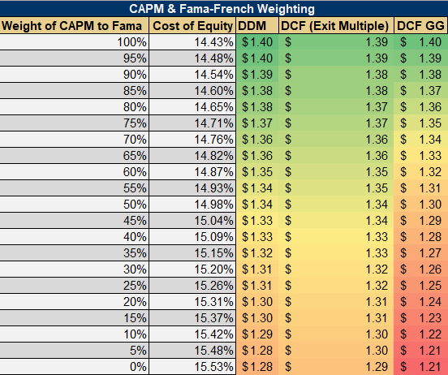
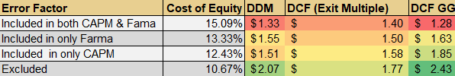
Sensitivity Analysis Error Factor

Slide 26

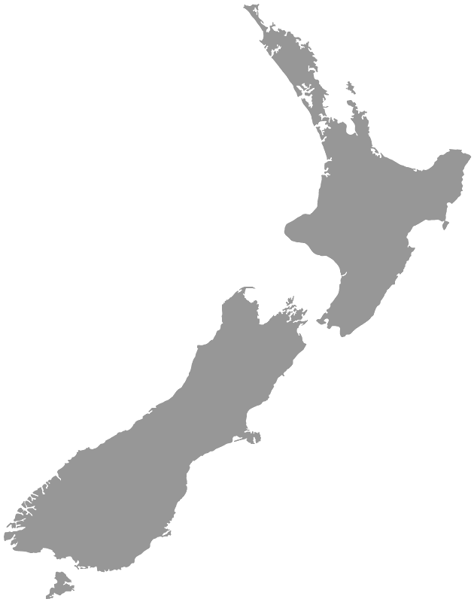
Terminal Growth Rate
GDP Growth Rate
≈ Sector Weights
2.10%
25%
2.03%
Terminal Growth Rate
2.00%
75%

Slide 27
Exit Multiple
Sensitivity Analysis
Exit Multiple | 7x | 7.5x | 8x | 8.5x | 9x | 9.5x | 10x | 10.5x | 11x | 11.5x | 12x | 12.5x | 13x | 13.5x | 14x | 14.5x | 15x
DCF | $1.19 | $1.27 | $1.34 | $1.41 | $1.49 | $1.56 | $1.63 | $1.71 | $1.78 | $1.85 | $1.93 | $2.00 | $2.07 | $2.15 | $2.22 | $2.29 | $2.37
Historical Multiple
Bloomberg Forecast
Chosen multiple
9.20x
12.09x
7.07x
26.32x
8.00x
Gordon Growth: $1.29
Cross Check

Slide 28
EBITDA Margin

Slide 29
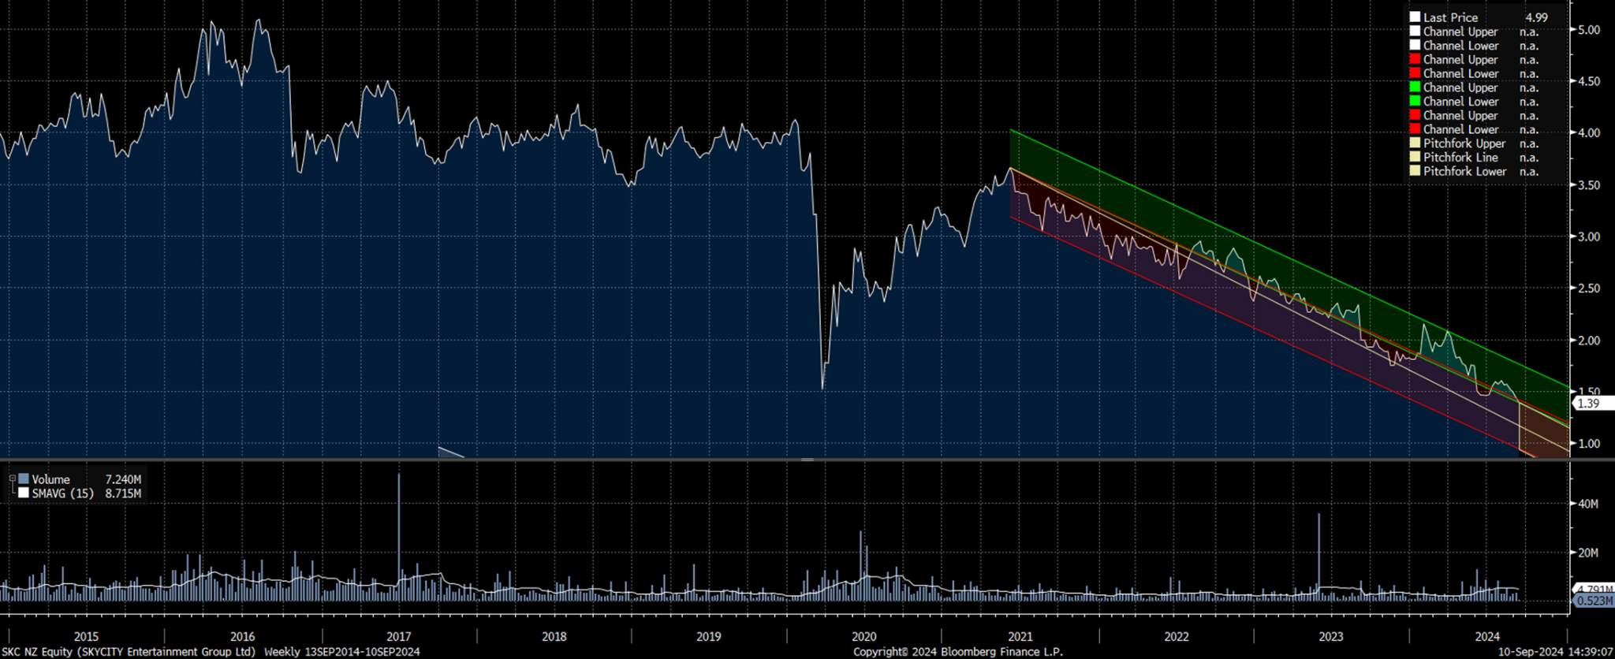
Investment Summary
Figure 10: Return to Risk Ratio
 | Standard Deviation | Alpha | Excess Return/Risk Ratio
SKC | 0.08 | -0.01 | -0.10%
DNA | 0.18 | -0.02 | -0.10%
TAH | 0.08 | 0.00 | -0.06%
SGR | 0.11 | -0.02 | -0.14%
SKC vs. Peers
Negative Ratios for All Companies: Indicating a poor risk-to-return payoff historically.
Pre- COVID: Horizontal price movement with little significant growth
Post- COVID: Clear negative trend, with no signs of recovery
Future projection: Based on the past 5 years of date, we anticipate this downward trend to continue due to lack of major announcements or catalysts

Slide 30
Dividend Discount Model
Payout Ratio
Adj. DPS
SKC Dividend Payout Policy
 |  | 2017 | 2018 | 2019 | 2020 | 2021 | 2022 | 2023 | 2024
DPS (cents) | $c | 0.200 | 0.200 | 0.200 | 0.100 | 0.700 | 0.000 | 0.120 | 0.053
YoY | % |  | 0.000 | 0.000 | -0.500 | 6.000 | -1.000 | - | -0.563
Payout Ratio | % | 1.998 | 0.502 | 0.879 | 0.566 | 0.333 | 0.000 | 0.636 | 0.693
DPS Theoretically | $c | 0.239 | 0.079 | 0.152 | 0.048 | 0.038 | - | 0.117 | 0.106
Difference | $c | -0.039 | 0.121 | 0.048 | 0.052 | 0.662 | - | 0.003 | -0.053
60%
90%
80%
* Team Consensus set payout ratio at 80%
Adj. Factor
11.3%
Forecasted Dividend PMT
 | FY25 | FY26 | FY27 | FY28 | FY29 | FY30 | FY31 | FY32 | FY33 | FY34 | Terminal Value
Dividends per Share (DPS) | 0.000 | 0.205 | 0.210 | 0.212 | 0.214 | 0.217 | 0.220 | 0.223 | 0.226 | 0.229 | 1.788
DPS Growth (g) |  |  | 2.6% | 0.8% | 1.0% | 1.2% | 1.5% | 1.5% | 1.4% | 1.5%
Present Value (PV) | 0.000 | 0.155 | 0.138 | 0.121 | 0.106 | 0.093 | 0.082 | 0.072 | 0.064 | 0.056 | 0.439
DDM Target: $1.33

Slide 31
Thesis 1: Net Debt/EBITDA
Despite sitting comfortably under their covenant limit of 3.75x, management’s caution my be warranted if the company’s earning challenges are more structural than cyclical.
Drivers: Regulatory changes, shifting consumer behavior, and forecasted reduction in land-based gambling, due to Card –to-Play Mandate.

Slide 32
Thesis 2: Erosion of Cash
Historical:
FY 2024 Cash Flow impacted mainly by capital work-in progress of NZICC and HH and weak core performance
Cash flow for FY 2024 ($184M) mainly due to Capex for NZICC and HH ($303M)
Unlevered Cash flows were ($107M) after accounting for core business and various project
Forecast:
FY 2025 unlevered cash flow expected to be ~$87M mainly by lower Capital expenditure on NZICC ($156M)
Cash flow from core business operations expected to rise slightly
NZICC expected completion FY 25

Slide 33
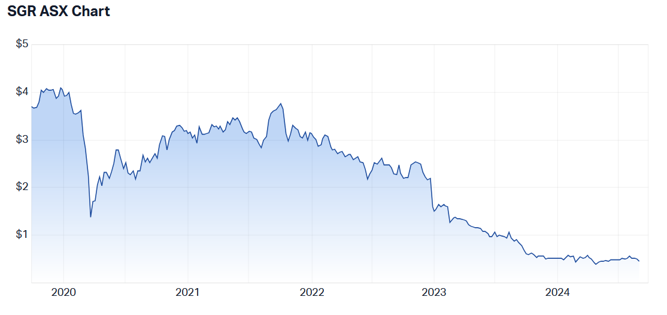
Thesis 3: A Challenging Regulatory Environment
SKC Share price has dropped consistently since COVID-19. Competitors are experiencing a similar trend
Mandatory card to play will negatively impact future revenues
Online gaming is increasing; however, this currently makes up only a minor portion of SKC’s revenue
SKC NZX Chart

Slide 34
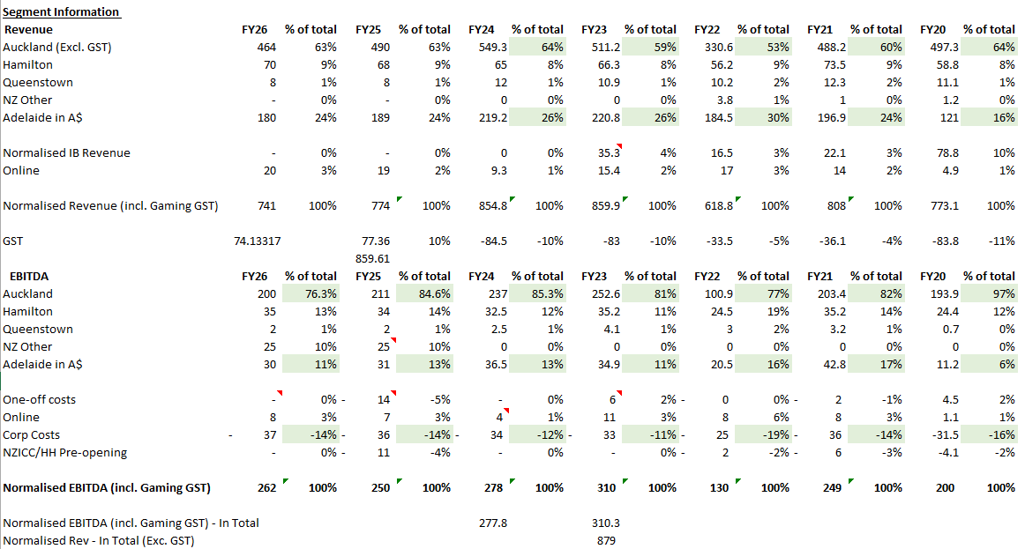
Thesis 3: Online Gaming Projections

Slide 35
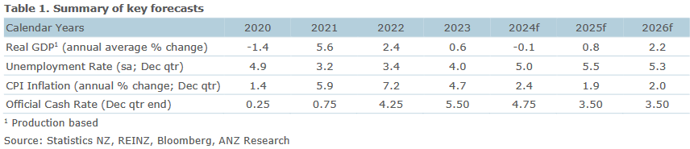
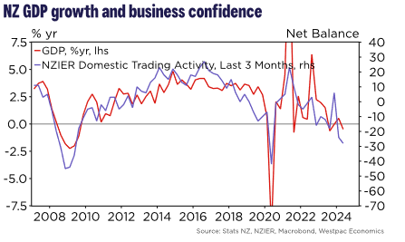
Economic Forecasts and Business Confidence

